Slide 1
Globalization: Good or Bad?
Professor Meyer

Slide 2
Definitions
Globalization: the process of international integration
Environment: your surroundings; the natural world
Ramifications: unwelcome or complex consequences
Migration: movement of people to find better work
Outsourcing: obtain goods or service from an outside supplier
Standard of living: the degree of wealth and material comfort available to a person or community
Detrimental: tending to cause harm
With your group, create 7 sentences, each using a different one of these vocabulary.

Slide 3


Globalization
Trade
Business
Migration of people
Exchange of knowledge
Notes:
mcdonalds; global interconnectness; human rights; MNCs; oursourcing;SARs; BP oil spill
Detox

Slide 4
In what ways can you see globalization in your everyday life?
Think:
  School
  Food
  Media: TV/Movies
  Culture
  Shopping

Slide 5
Pros
Developing countries: better economy, standard of living, access to advanced technologies
Notes:
Con: bubonic plague in the dark ages
As more money is poured in to developing countries, there is a greater chance for the people in those countries to economically succeed and increase their standard of living.
Global competition encourages creativity and innovation and keeps prices for commodities/services in check.
Developing countries are able to reap the benefits of current technology without undergoing many of the growing pains associated with development of these technologies.
Governments are able to better work together towards common goals now that there is an advantage in cooperation, an improved ability to interact and coordinate, and a global awareness of issues.
There is a greater access to foreign culture in the form of movies, music, food, clothing, and more. In short, the world has more choices.

Slide 6
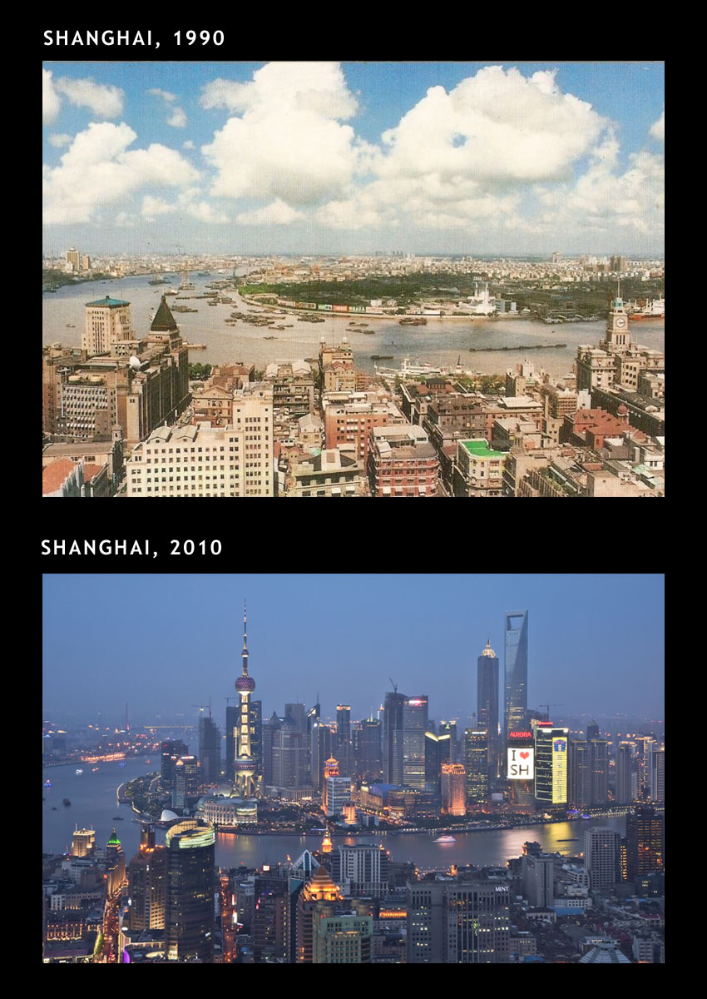
Standard of Living Increase

Slide 7
Pros
Developing countries: better economy, standard of living, access to advanced technologies
Global competition encourages innovation and keeps prices down
Notes:
Con: bubonic plague in the dark ages
As more money is poured in to developing countries, there is a greater chance for the people in those countries to economically succeed and increase their standard of living.
Global competition encourages creativity and innovation and keeps prices for commodities/services in check.
Developing countries are able to reap the benefits of current technology without undergoing many of the growing pains associated with development of these technologies.
Governments are able to better work together towards common goals now that there is an advantage in cooperation, an improved ability to interact and coordinate, and a global awareness of issues.
There is a greater access to foreign culture in the form of movies, music, food, clothing, and more. In short, the world has more choices.

Slide 8

Global Competition

Slide 9
Pros
Developing countries: better economy, standard of living, access to advanced technologies
Global competition encourages innovation and keeps prices down
Government cooperation towards common goals
Notes:
Con: bubonic plague in the dark ages
As more money is poured in to developing countries, there is a greater chance for the people in those countries to economically succeed and increase their standard of living.
Global competition encourages creativity and innovation and keeps prices for commodities/services in check.
Developing countries are able to reap the benefits of current technology without undergoing many of the growing pains associated with development of these technologies.
Governments are able to better work together towards common goals now that there is an advantage in cooperation, an improved ability to interact and coordinate, and a global awareness of issues.
There is a greater access to foreign culture in the form of movies, music, food, clothing, and more. In short, the world has more choices.

Slide 10

Common Goals

Slide 11
Pros
Developing countries: better economy, standard of living, access to advanced technologies
Global competition encourages innovation and keeps prices down
Government cooperation towards common goals
Diversity; access to foreign cultures
Notes:
Con: bubonic plague in the dark ages
As more money is poured in to developing countries, there is a greater chance for the people in those countries to economically succeed and increase their standard of living.
Global competition encourages creativity and innovation and keeps prices for commodities/services in check.
Developing countries are able to reap the benefits of current technology without undergoing many of the growing pains associated with development of these technologies.
Governments are able to better work together towards common goals now that there is an advantage in cooperation, an improved ability to interact and coordinate, and a global awareness of issues.
There is a greater access to foreign culture in the form of movies, music, food, clothing, and more. In short, the world has more choices.

Slide 12
Cons
Outsourcing
Melting pot theory
Notes:
Outsourcing, while it provides jobs to a population in one country, takes away those jobs from another country, leaving many without opportunities.
Although different cultures from around the world are able to interact, they begin to meld, and the contours and individuality of each begin to fade.
There may be a greater chance of disease spreading worldwide, as well as invasive species that could prove devastating in non-native ecosystems.
There is little international regulation, an unfortunate fact that could have dire consequences for the safety of people and the environment.
Large Western-driven organizations such as the International Monetary Fund and the World Bank make it easy for a developing country to obtain a loan. However, a Western-focus is often applied to a non-Western situation, resulting in failed progress.
mcdonalds; global interconnectness; human rights; MNCs; oursourcing;SARs; BP oil spill
Detox

Slide 13



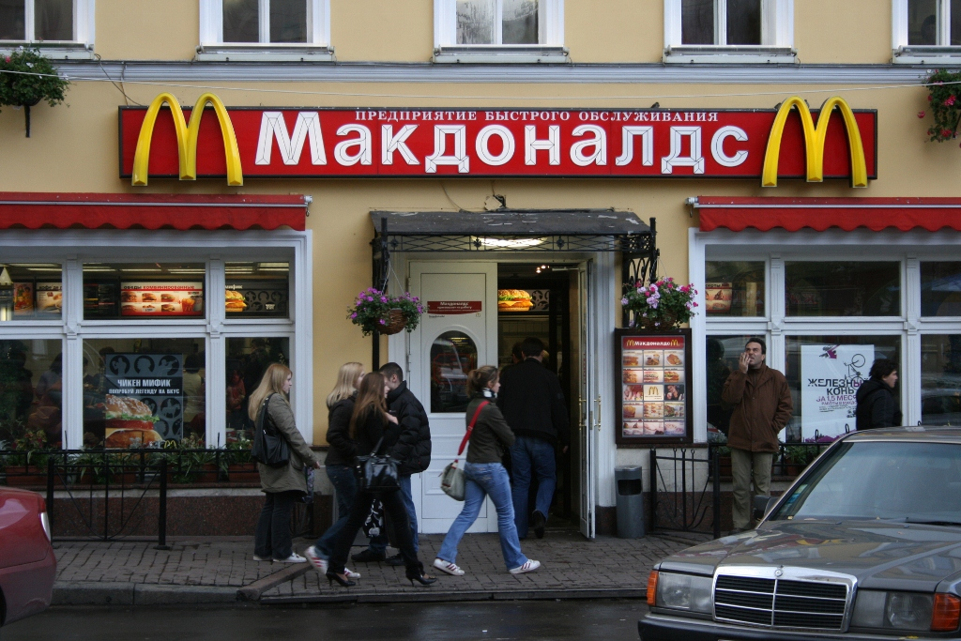
Notes:
Control; predictability; calculability; efficiency

Slide 14
Cons
Outsourcing
Melting pot theory
Disease and invasive species
Notes:
Outsourcing, while it provides jobs to a population in one country, takes away those jobs from another country, leaving many without opportunities.
Although different cultures from around the world are able to interact, they begin to meld, and the contours and individuality of each begin to fade.
There may be a greater chance of disease spreading worldwide, as well as invasive species that could prove devastating in non-native ecosystems.
There is little international regulation, an unfortunate fact that could have dire consequences for the safety of people and the environment.
Large Western-driven organizations such as the International Monetary Fund and the World Bank make it easy for a developing country to obtain a loan. However, a Western-focus is often applied to a non-Western situation, resulting in failed progress.
mcdonalds; global interconnectness; human rights; MNCs; oursourcing;SARs; BP oil spill
Detox

Slide 15

Disease outbreak: SARs

Slide 16
Cons
Outsourcing
Melting pot theory
Disease and invasive species
Environment problems
Notes:
Outsourcing, while it provides jobs to a population in one country, takes away those jobs from another country, leaving many without opportunities.
Although different cultures from around the world are able to interact, they begin to meld, and the contours and individuality of each begin to fade.
There may be a greater chance of disease spreading worldwide, as well as invasive species that could prove devastating in non-native ecosystems.
There is little international regulation, an unfortunate fact that could have dire consequences for the safety of people and the environment.
Large Western-driven organizations such as the International Monetary Fund and the World Bank make it easy for a developing country to obtain a loan. However, a Western-focus is often applied to a non-Western situation, resulting in failed progress.
mcdonalds; global interconnectness; human rights; MNCs; oursourcing;SARs; BP oil spill
Detox

Slide 17




Slide 18
Cons
Outsourcing
Melting pot theory
Disease and invasive species
Environment problems
IMF forces Western principles on non-Western countries
Notes:
Outsourcing, while it provides jobs to a population in one country, takes away those jobs from another country, leaving many without opportunities.
Although different cultures from around the world are able to interact, they begin to meld, and the contours and individuality of each begin to fade.
There may be a greater chance of disease spreading worldwide, as well as invasive species that could prove devastating in non-native ecosystems.
There is little international regulation, an unfortunate fact that could have dire consequences for the safety of people and the environment.
Large Western-driven organizations such as the International Monetary Fund and the World Bank make it easy for a developing country to obtain a loan. However, a Western-focus is often applied to a non-Western situation, resulting in failed progress.
mcdonalds; global interconnectness; human rights; MNCs; oursourcing;SARs; BP oil spill
Detox

Slide 19
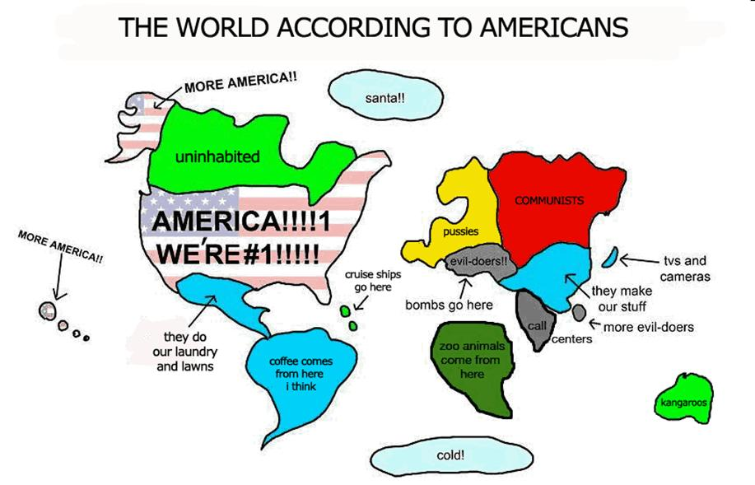

Slide 20
Friend of Foe?
What do you think?
Discuss with your group the ways in which globalization has helped or has hurt the world.

Slide 21
Debate
Debate: a game in which two opposing teams make speeches to support their arguments and disagree with those of the other team.
Resolution: the opinion about which two teams argue.
Affirmative team: agrees with the resolution.
Negative team: disagrees with the resolution.
Rebuttal: explains why one team disagrees with the other team.
Judges: decide the winner.

Slide 22
Opinions and Reasons
I think/believe that smoking should be banned in universities because/since secondhand smoke is harmful.

Slide 23
Strong v. Weak Reasons
Strong reasons should…
  …logically support the opinion.
  …be specific and clearly state the idea.
  …be convincing to a majority of people.
Smoking should be banned in universities because…
  Strong: …it is linked to lung cancer.
  Weak: …it is bad.
It is better to be married than to be single because…

Slide 24
Ways to Reason
Comparison
  X is ______er than Y.
  Y is more ______ than X
Cause and effect
  X causes Y.
  If you do X, then Y will happen.
  X is strongly linked to Y.
Examples
  For example, …
  For instance, …
  In my personal experience, …
  A personal example, …
Common sense
  Everyone knows that…
  It is common knowledge that…
Expert opinion/Statistics
  According to a study, …

Slide 25
Debate Resolution
This house believes that globalization is detrimental to the human race.
Comparison
  X is ______er than Y.
  Y is more ______ than X
Cause and effect
  X causes Y.
  If you do X, then Y will happen.
  X is strongly linked to Y.
Examples
  For example, …
  For instance, …
  In my personal experience, …
  A personal example, …
Common sense
  Everyone knows that…
  It is common knowledge that…
Expert opinion/Statistics
  According to a study, …

Slide 26
Pros
Cons
Developing countries: better economy, standard of living, access to advanced technologies
Global competition encourages innovation and keeps prices down
Government cooperation towards common goals
Diversity; access to foreign cultures
Outsourcing
Melting pot theory
Disease and invasive species
Environment problems
IMF forces Western principles on non-Western countries
Notes:
Con: bubonic plague in the dark ages
As more money is poured in to developing countries, there is a greater chance for the people in those countries to economically succeed and increase their standard of living.
Global competition encourages creativity and innovation and keeps prices for commodities/services in check.
Developing countries are able to reap the benefits of current technology without undergoing many of the growing pains associated with development of these technologies.
Governments are able to better work together towards common goals now that there is an advantage in cooperation, an improved ability to interact and coordinate, and a global awareness of issues.
There is a greater access to foreign culture in the form of movies, music, food, clothing, and more. In short, the world has more choices.

